Slide 1
Sustainable Digital Creativity
25th August 2020
Becky Hazlewood
Environmental Sustainability Project Manager
Julie’s Bicycle
Notes:
Hi we’re just going to mute and pause this while we wait for everyone to arrive.

Slide 2
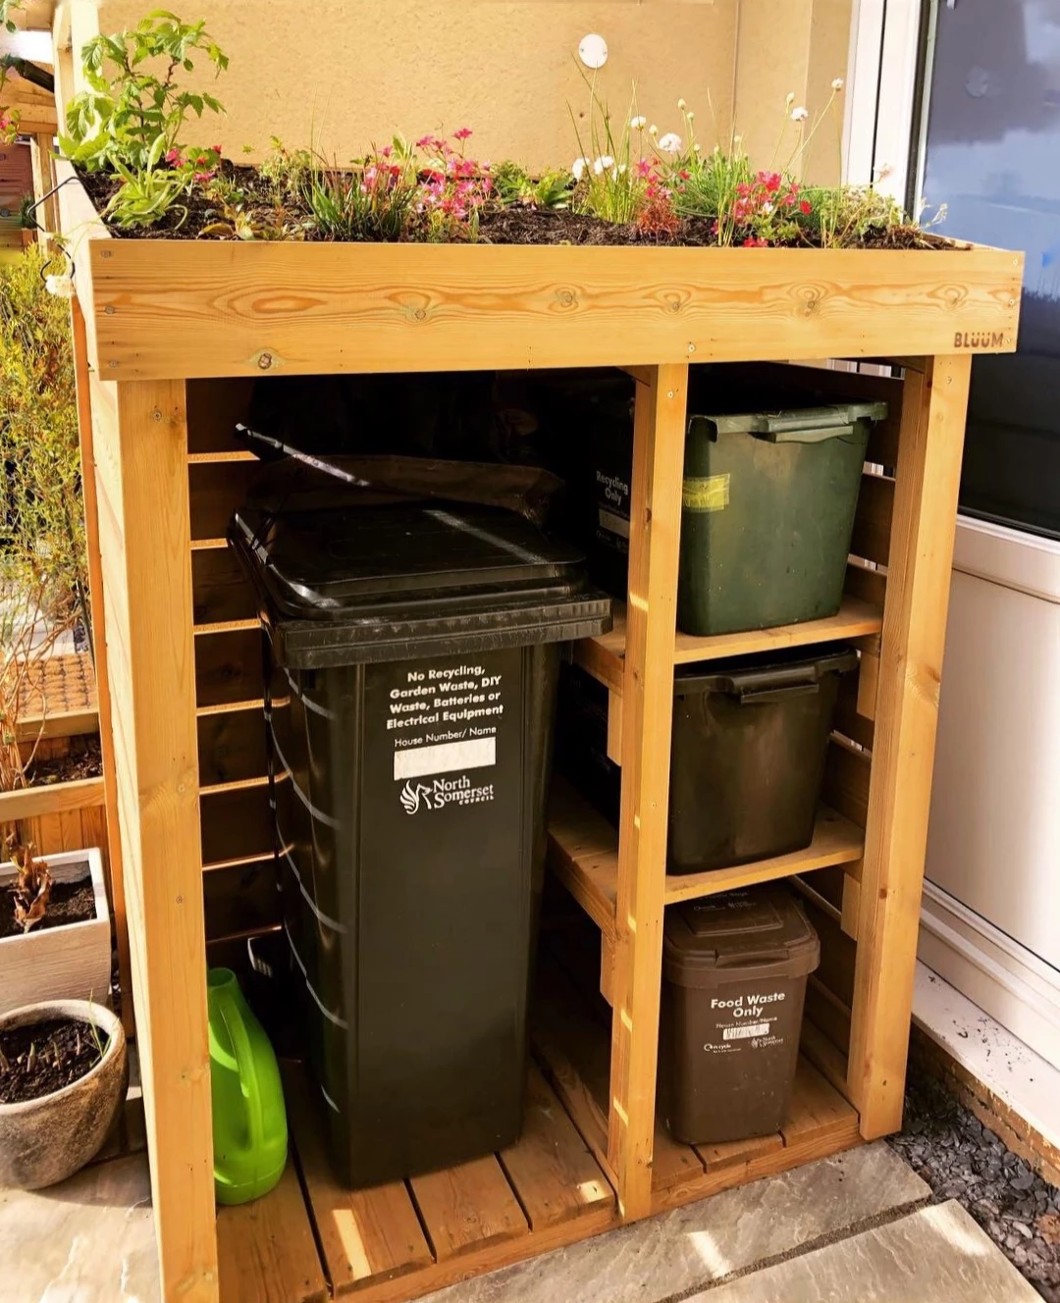
House Keeping
Raising hands
Asking questions
Recordings
Audience

Slide 3
Julie’s Bicycle
Culture and creativity powering environmental action
Our objectives:
Support culture to limit global heating to 1.5 degrees
Advocate for culture to inspire action on climate change and sustainability

Slide 4
Consultancy
Environmental sustainability
Policy
Advocacy
Research
Training
Tools & Resources
Convening
Inspiration
Arts &
creative industries

Slide 5
Energy efficiency & carbon reductions
Resilience
Benefits beyond carbon savings – creativity, team morale, strategy, collaboration, reputation

Slide 6
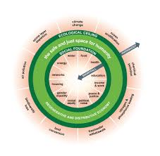
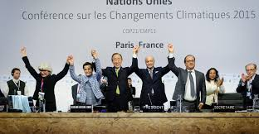
A Just, Green, Cultural Sector
Decarbonisation i.e. an immediate, rapid and urgent reduction in greenhouse gas emissions to net zero;
Circularity i.e. a regenerative economy decoupled from resource use
Justice i.e. no person or place is left behind in the transition
Notes:
Committee on Climate Change Annual Report: 25/6/2020
Prime Minister is not doing enough – leadership needed.
1,2 and 3 carbon budgets met, third helped by Corona virus
4 and 5 not likely to be met under current trajectories
Must focus on a green recovery ahead of COP26, a once-in-a-lifetime opportunity. General path to net-zero is “already clear”, according to the report. But we need a full policy package covering every part of the economy by 2025, and virtually all new investments, from cars to heating systems, to be zero-carbon by 2035 at the latest.
Too much investment already committed to high carbon industries, airlines and road infrastructure with no green conditions. Globally Carbon dioxide emissions dropped by 17% (globally) compared with last year, but have since surged to about 5% of last year’s levels. Governments are planning to spend $9tn (£7.2tn) globally in the next few months on rescuing their economies from the coronavirus crisis, the IEA has calculated. The stimulus packages created this year will determine the shape of the global economy for the next three years and within that time emissions must start to fall sharply and permanently or we will fail.“The next three years will determine the course of the next 30 years and beyond,” Fatih Birol (Exec Director of IEA)
That’s why we’re calling for a just and green cultural recovery combining targeted public investment (green cultural renewal fund), clear policy signals (for the transition we need), and that implementation of the UK’s legal Climate Change Act obligations is a core part of the Cultural Renewal strategy. This is a once-in-a-lifetime moment and break from normal – and with the UK hosting the international COP26 climate negotiations, demonstrating this ambition on the world stage is even more important. Everything should be on the table.
This moment coincides with a major exposure of inequality and institutional racism. Climate and social justice are intimately connected.
In industrialised economies the inequalities revealed by Covid 19 map directly across to climate and nature: poorer communities have less access to green space, decent housing (insulated, allotments. Gardens, safe, accessible), more likely to be in high pollution spots, less money for fresh food/organic/clean energy). And these voices are the most marginalised and rarely platformed.
We will have to make a choice about how and where we focus our recovery post-rescue. Hundreds of businesses, networks and industry bodies (including the International Energy Agency) are calling this a ‘once in a lifetime’ chance for a green recovery. But there are also some already trying to edge climate and environmental commitments out of the picture – this idea of ‘recovery at any cost’, which suggests that the people saying it think we can’t walk and chew gum at the same time when making policy and investment decisions – but of course we must.

Slide 7
Agenda
What are digital impacts?
Devices and E-Waste
The footprint of the internet
Practical Actions
Guest Speaker: Dan Barnard, Fast Familiar
Q and A
Notes:
Pros of digital
Shift to digital in the arts
Dematerial but not decarbonised

Slide 8
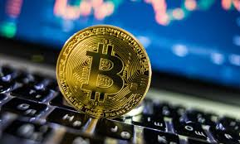
Digital Age - Digital Art
Notes:
What do you think creates and causes the most internet traffic?
watching videos and playing games online, browsing the web and scrolling our social media feeds (four activities that, together, make up nearly 90 percent of traffic downloaded from the web, according to a 2018 report by networking company Sandvine).
Problem is that we are consuming ever larger amounts of data, using internet more and more, storing and using more data…infrastructure gets more efficient can just mean we use more….especially with the introduction of technologies such as 5G
researchers have estimated the internet could consume more than a fifth of the world’s electricity by 2030.- if that were any other sector alarm bells would be ringing

Slide 9
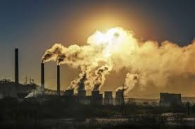
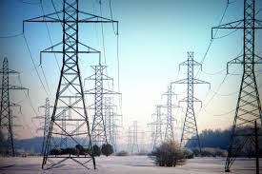
So how significant are digital impacts?
If the internet was a country, in terms of greenhouse gas emissions it would be the sixth largest polluter.
If the IT sector were a country, it would be the 3rd highest consumer of electricity after the USA and China.
Notes:
Every search requires multiple servers
Manufacturing- servers, computers, smartphones
Powering and cooling- devices, data centres,

Slide 10
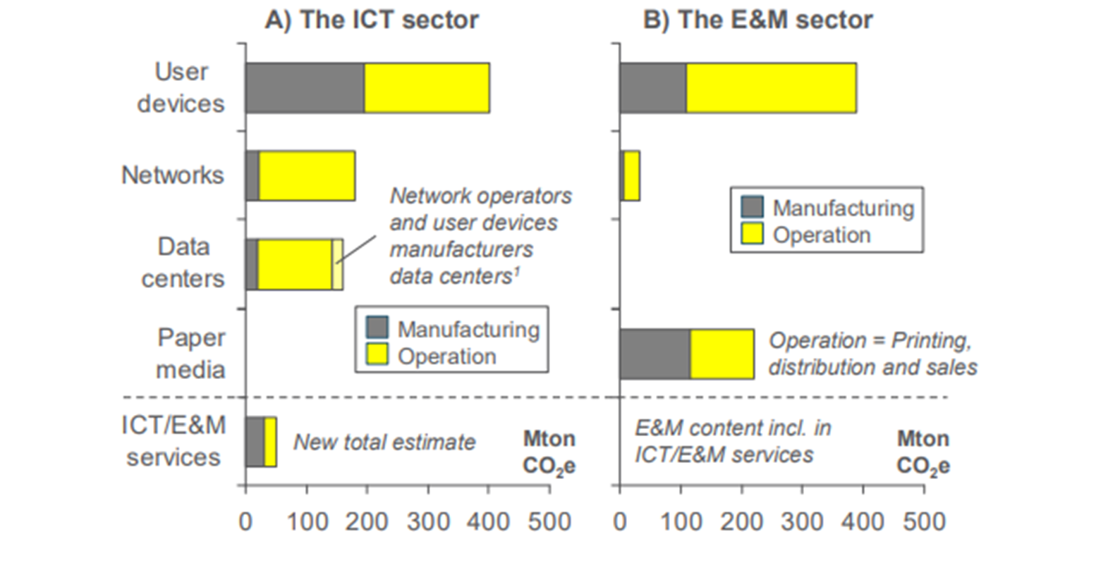
Digital Impacts- what are they and where do they come from?
1.4% ghg
4% elec
1.2% ghg
3% elec
2015 Total carbon footprint for ICT and EM sector, Source: Malmodin and Lunden 2018
Notes:
Broadly Speaking when measuring carbon impacts they are split into those from the ICT sector, for example, the devices we use and the impacts that come with manufacturing them, the networks that transmit our data, the huge data centres that store all of our data in the cloud and that host all the information on the internet so that we can access it 24/7.
The Entertainment and media sector is measured separately but includes streaming entertainment, TV, gaming and newspapers.
You can see from the graph here that for devices in the E and M sector the impact of operating devices is higher than the manufacture impact.
The total life cycle carbon footprint of the ICT sector is equivalent to 1.4% of global greenhouse gas emissions and around 4% global electricity use. The entertainment and media sector (TV, gaming, streaming entertainment, newspapers) accounts for an additional 1.2% of global emissions and 3% of global electricity consumption. In a best-case scenario, predictions suggest that globally renewable energy production should exceed data centre consumption by 2030, however worst-case estimates suggest communications technology electricity usage could contribute up to 23% of global greenhouse gas emissions by 2030.
If the internet was a country, in terms of greenhouse gas emissions it would be the sixth largest polluter.
If the IT sector were a country, it would be the 3rd highest consumer of electricity after the USA and China.
Malmodin & Lunden (2018) The Energy and Carbon Footprint of the Global ICT and E&M Sectors 2010–2015. Sustainability. vol. 10, no. 9. https://www.mdpi.com/2071-1050/10/9/3027
On Global Electricity Usage of Communication Technology: Trends to 2030
by Anders S. G. Andrae and Tomas Edler, Challenges 2015, 6(1), 117-157; https://doi.org/10.3390/challe6010117
Digital Detox, The Green Report, 2020, https://blog.digital-detox.co.uk/digital-pollution-solution-green-report/?inf_contact_key=3f31704198c74156a47cf5a930328569
Greenpeace, 2017, Click Green Report, http://www.clickclean.org/uk/en/
Maybe change generally to greenhouse gas emissions….
Having read the TechUK FAQs I think it would be better not to include the worst case figure – either give the range – best to worst or the middle…
Would be better to have a number on emissions rather than electricity – or maybe even both – electricity + GHGs – this is absolutely one of the key issues for digital – electricity source vs electricity use
I read somewhere a nice figure re. GHGs e.g it would be world’s 6th biggest emitter of GHGs

Slide 11
Digital Emissions and Impacts
Devices
-Use
Communication Networks
Data Centres
Manufacture
34%
29%
21%
16%
Energy and E-Waste
Construction, Operation, Maintenance
Fossil Fuel expansion
Energy Consumption
Source: Greenpeace, 2017,Click Green
Notes:
Devices (34%) –energy used to power our phones, tablets, desktops, wearables etc
Communication Networks (29%)- construction, operation and maintenance of networks for both mobile and fixed networks
Data Centres (21%)- construction, manufacture and operation of the centres that store all the data on the internet
Manufacture (16%)- energy for making all the equipment
Greenpeace, 2017, Click Green Report, http://www.clickclean.org/uk/en/
Despite the combined data sets, the embodied footprints of user devices represent the most uncertain part of the footprints as they cannot be easily measured in an accurate way. For the use stage, information is lacking regarding usage profiles, if the usage is extended or limited, if the device is on or off grid or if the connectivity is based on a fixed connection, a WiFi or 4G. All these aspects have a considerable impact on the estimated device’s footprint.
We’ll now look at these impact areas in a little more detail and look at some practical actions you can take to reduce your digital footprint.

Slide 12
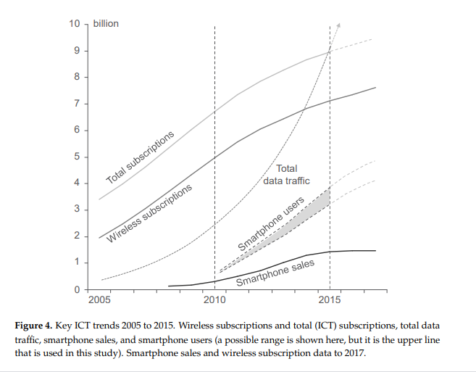
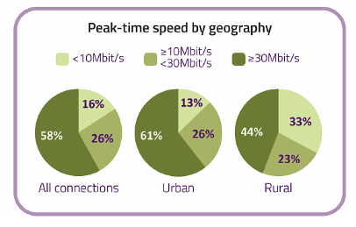
The (Sustainable?) Growth of Digital
2.5 our of 7.5 billion are connected to the world-wide web
Sales of smart phones: 300 million in 2010 to 1.56 billion in 2018.
UK- roll out of fibre-optic- digital benefits not equal across UK.
Source:Malmodin & Lunden (2018) The Energy and Carbon Footprint of the Global ICT and E&M Sectors 2010–2015.
Source: Ofgem, 2019.
Notes:
An estimated 2.5 out of 7.5 billion people world-wide are now connected to the web and on a global level, sales of smartphones have rocketed from 300 million in 2010 to more than 1.56 billion in 2018. https://www.custommade.com/blog/carbon-footprint-of-internet/
https://www.statista.com/statistics/263437/global-smartphone-sales-to-end-users-since-2007/
In addition, the Government wants Gigabit capable “full fibre” FTTP/H services to cover 10 million premises by 2022, then 15 million by 2025 and it has an aspiration for “nationwide” coverage by 2033 (here). In theory this could resolve concerns over the rural vs urban divide, but assuming that’s even achievable then it’s still a very long way off and in the meantime the divide will remain.

Slide 13
Digital Footprints can be complex…
What data is readily available?
What is not possible or hard to influence?

Slide 14
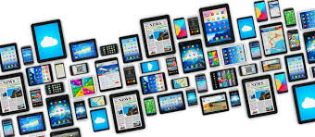
Agenda
What are digital impacts?
-Emissions and issues
Devices and E-Waste
-issues
-action you can take
The footprint of the internet
-issues
-Action you can take
Guest Speaker: Dan Barnard, Fast Familiar
Q and A

Slide 15
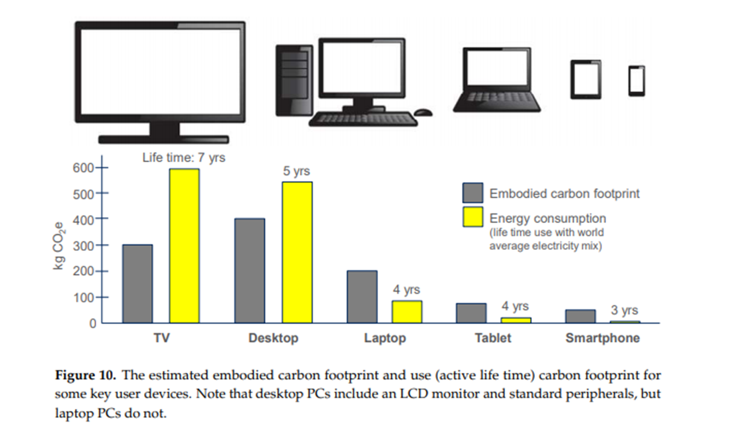
Device Impacts
Ethical Credentials?
Size of device
How you use it- 4G, Wifi
Type of use e.g. website vs streaming content
Fixability, Recyclability, Reuse potential
Source:Malmodin & Lunden (2018) The Energy and Carbon Footprint of the Global ICT and E&M Sectors 2010–2015.
Notes:
Dependent on a number of factors- consider the LIFECYCLE of the device
*Where have the materials used to make the device come from? Mining earth minerals comes with an environetal and social impact e.g…..Tungsten, Tin, Gold, tantalum Tin is used as a circuit board solder for electronics; (center) tantalum stores electricity and is used in cellular phone batteries and other electronics; (right) tungsten makes cellular phones vibrate
Fairphone example- Certified Gold.
Manufacture- energy and water intensive processes
*Transport- often shipped long distance to reach users
How do you use the device?
We now ship around 1.5 billion smart phones per year, selling about sixty per second. For each phone manufactured, approximately 30 kilos of rock is mined in order to extract 100g of minerals. The minerals used in electronic devices are often rare and mining practices have been associated with poor labour conditions, child labour, unfair pay, armed conflict deforestation and land degradation. Manufacturing is energy intensive, for example, smartphone manufacture produces the equivalent emissions of the Philippines per year. Furthermore, both mining and manufacturing are water intensive processes .
In Europe discarded electronic devices present a material loss of 500 million USD annually, however 75% of electronic devices can be recycled. Challenges include design complexity and lack of standardisation, legal issues, pace of technological change, use of rare, difficult to recycle elements, user perception and behaviours, expense of repairs and developing effective systems to recover products.
Use your device for longer, pass it on or get it fixed before buying a new one
If you can’t do any of the above and need to recycle your device then the UK campaign Recycle Your Electricals gives information on how and where devices can be recycled
Consider recycling services such as Mazuma Mobile; an online mobile phone reuse and recycling service which gives same day cash payments for mobile phones, the handsets are refurbished and sold on. Other similar initiatives include O2 Recycle, Apple Recycling Programme or community initiatives and social enterprises such as The Restart Project or Repair Cafe which involve teaching people to fix and upcycle all sorts of devices
Are you a cable hoarder? Hidden in our homes are 370,000 tonnes of cables! Cable Amnesty, a partnership between Colchester Borough Council and Colchester Arts Centre, are on a mission to purge you of your cables, so they can be recycled!
Consider buying a refurbished device, they work just as well and are often cheaper
Before replacing or purchasing, research your device choice- does the company have a circular economy strategy or a renewable energy strategy based on Science Based Targets rather than vague commitments not backed by action? Some companies provide options to trade in old for new devices. Fairphone for example is built with a modular design, so component parts can be easily replaced, as well as using recycled plastics and Fairtrade metals
Gartner, 2018 https://www.gartner.com/en/newsroom/press-releases/2018-01-29-gartner-says-worldwide-device-shipments-will-increase-2-point-1-percent-in-2018
https://therestartproject.org/the-global-footprint-of-mobiles/
https://www.ellenmacarthurfoundation.org/news/in-depth-mobile-phones
Catherine Westman, A circular economy handbook for businesses and supply chains: repair, remake, redesign, rethink
This info might be quite nice summarised as an infographic something like this: (excuse my drawing- I will look to see if there’s anything existing like this online!)
e-waste could represent an opportunity worth over 62.5 billion dollars per year with the potential of creating millions of decent new 'clean and green' jobs worldwide. (ITU)

Slide 16
Source: World Economic Forum 2020
Notes:
Each Stage:
Design- use recycled materials or sustainable materials that can be recycled, design for longevity and reuse
Manufacturing- transparency of processes, energy sourcing, action taken to reduce impacts
Life extension: Use for as long as possible, fix it, pass on to someone else person or charity to use (second life), find intiatives where you can recycle it- some offer cash back- collection points RecycleUK campaign- mention, find out key points.
Mention barriers to recycling and re-use- what can the sector do to encourage behaviour change/change perceptions

Slide 17
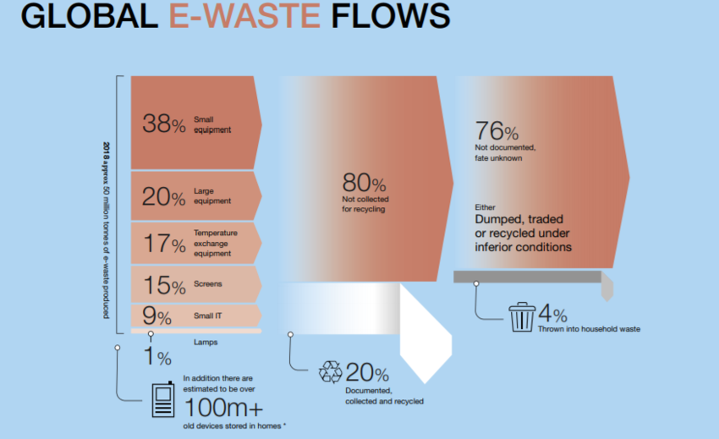
Source: World Economic Forum 2020
Notes:
Stats on E-Waste
Hoarder- issues such as data protection lead us to keep phones in drawers
Note we are better in UK and Europe- stats from Susanne
Emphasise this is a huge economic and environmental opportunity- stats from briefing
e-waste could represent an opportunity worth over 62.5 billion dollars per year with the potential of creating millions of decent new 'clean and green' jobs worldwide. (ITU)
In Europe discarded electronic devices present a material loss of 500 million USD annually, however 75% of electronic devices can be recycled. Challenges include design complexity and lack of standardisation, legal issues, pace of technological change, use of rare, difficult to recycle elements, user perception and behaviours, expense of repairs and developing effective systems to recover products.
Use your device for longer, pass it on or get it fixed before buying a new one
If you can’t do any of the above and need to recycle your device then the UK campaign Recycle Your Electricals gives information on how and where devices can be recycled

Slide 18
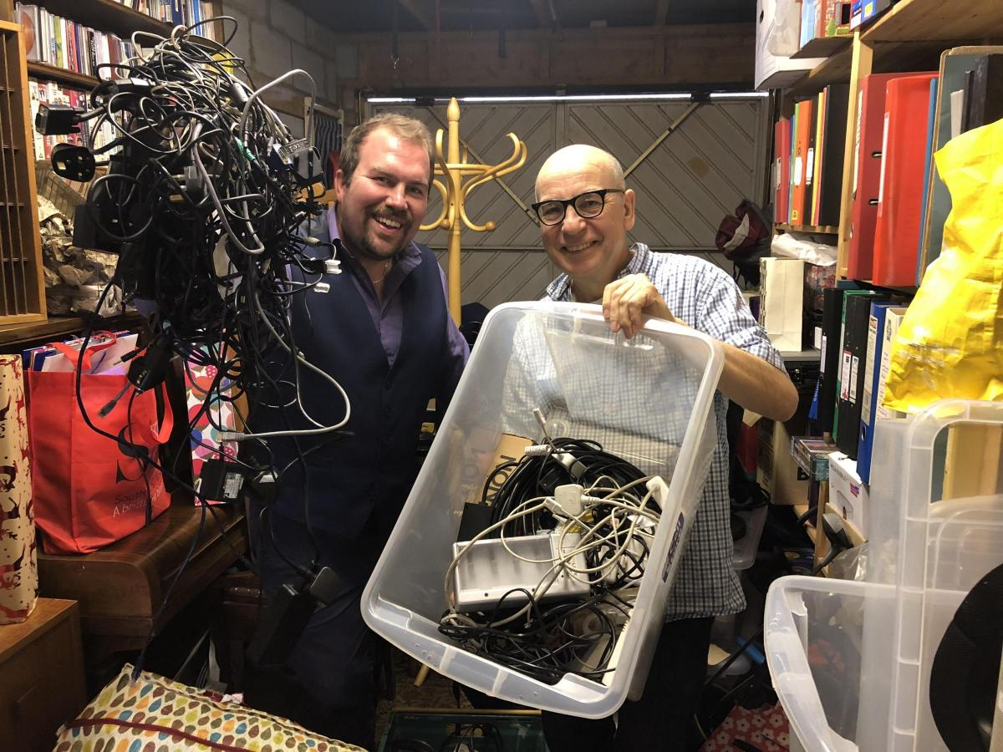
Cable Amnesty Colchester Collaboration
Colchester Arts Centre and Colchester Borough Council
Donate at Farmers Market or pick up cables you need
Notes:
Are you a cable hoarder? Hidden in our homes are 370,000 tonnes of cables! Cable Amnesty, a partnership between Colchester Borough Council and Colchester Arts Centre, are on a mission to purge you of your cables, so they can be recycled!
We are working with Enform the environmental agency and Colchester Borough Council recycling team to ensure their responsible disposal.
There will of course be prizes. Sexiest cable, rarest cable, oldest cable etc - and you are most welcome to come and take whatever cables are useful to you home. All free.

Slide 19
Agenda
What are digital impacts?
-Emissions and issues
Devices and E-Waste
-issues
-action you can take
The footprint of the internet
-issues
-Action you can take
Guest Speaker: Dan Barnard, Fast Familiar
Q and A

Slide 20
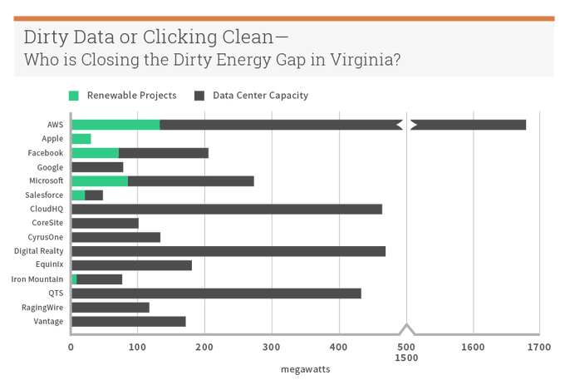
2) The Footprint of the Internet
In the UK and EU data centres are largely powered by the grid, some have onsite renewables
In USA the picture is very different, with data centres consuming large amounts of power from fossil fuel heavy energy mixes
Notes:
A vast, expansive network of infrastructure such as cables, communication towers, data centres and servers are required to fuel the world-wide web. Every piece of data stored in the cloud, every email we send and every website we visit requires energy to power them, and that physical infrastructure is working away all the time, even though it is not visible to us with each click. The vast majority of these data centres are located in Northern Virginia, USA, where a rapidly expanding city of data centres called “Data Centre Alley” run 24 hours a day, in a state where the energy mix is dominated by fossil fuels. Despite many tech companies making renewable energy commitments, only a fraction of data centre energy capacity is powered by on-site renewable projects across the board (with the exception of Apple) . Instead, many green claims are linked to off-setting meaning data centres continue to fuel local demand for energy and fossil fuel companies continue to expand their investment in infrastructure such as the proposed Atlantic Coast Pipeline to match their demand, locking in unsustainable paths of consumption which take us in the opposite direction of the deep cuts needed to stay below 1.5 degrees of warming.
Greenpeace, https://www.greenpeace.org/usa/reports/click-clean-virginia/#executive-summary
Link to JB guide

Slide 21
Data Centres: Engines of the Digital Economy
A very large data centre may consume 30GWh of power in a year, costing its operator around £3,000,000 for electricity alone.
Vary in efficiency
Vary in emissions dependent on location/energy source
Notes:
Data centres: a building housing computing facilities such as servers, routers- they provide a secure and conditioned environment for electronic and data processing equipment.
supporting critical national infrastructures, telecommunications, government operations and security, they deliver corporate IT services, e-government services, financial services, digital media, mobile computing and knowledge management. Yes, they enable social networking, internet access, online shopping and gaming but they also underpin all the technologies that enable a low carbon economy, such as smart grid, intelligent transport systems, smart buildings and smart cities. They even facilitate a whole range of virtual substitutes for carbon intensive activities, such as virtual presence and transport substitution technologies, e-commerce and access to creative content through digital downloads. Data centres pervade and enable our everyday activities, from commuting to shopping.
run IT and need cooling-
Data centres rely on energy from the grid so their emissions depend largely on the energy mix of the grid in the country where they are located…
Powering data centres from renewables or low carbon generation on site is problematic because data centres need constant and reliable power supply and this is not yet feasible using current technologies.
Adopting cloud-based IT strategies and using smart technologies will be essential to sustain these environmental benefits. While legacy technology, such as on-premises data centres, are a huge consumer of power and a significant contributor to carbon emissions, cloud services are much more environmentally friendly. This is due to the cloud computing model that encourages the consolidation and use of fewer larger data centres that can run more efficiently and reduce carbon emissions up to 50%. We can easily see that cloud-based services are better for the planet and can also help to facilitate remote working initiatives by providing video streaming services and collaboration applications helping to maintain productivity while keeping the impact of commuting to a minimum.
https://www.techuk.org/insights/opinions/item/18209-how-smarter-it-can-lead-to-a-greener-healthier-planet

Slide 22
Action: Ask your service provider/Make the switch!
Look for:
Science Based Targets
Transparency, Accountability and carbon reporting
Renewable energy onsite or through a PPA not reaching carbon neutral through offsets.
1) Sustainability policies and practices,
2) Facility management and equipment and,
3) Data centre power sources.
Notes:
Switch to web hosting and cloud services which are renewably powered and service providers which are transparent and accountable on their energy sources, greenhouse gases and targets . It is important to understand company renewable energy claims- for example whether the energy is generated on site or whether it has been achieved by less effective means such as offsets. Greenpeace’s Company Scorecards for digital services, tells you which companies and apps are living up to their green claims allowing you to opt for more sustainable services. This paper by the Coed Ethics Community analyses the pros and cons of the top six providers.
Have set Science-Based Targets. You might be interested in this guide we produced to help those buying cloud services to interpret data and ask the right questions https://www.techuk.org/insights/reports/item/16253-attributing-carbon-to-cloud
Maybe this should be the second action: its probably the most impactful action from a user perspective.

Slide 23
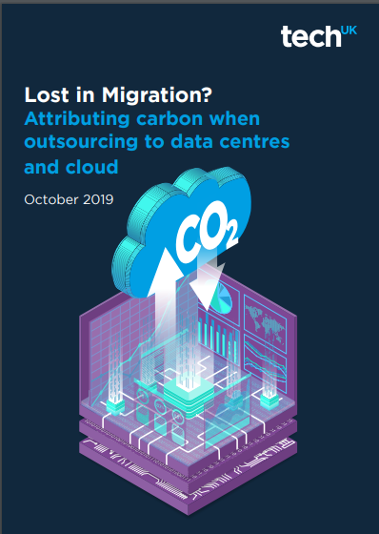
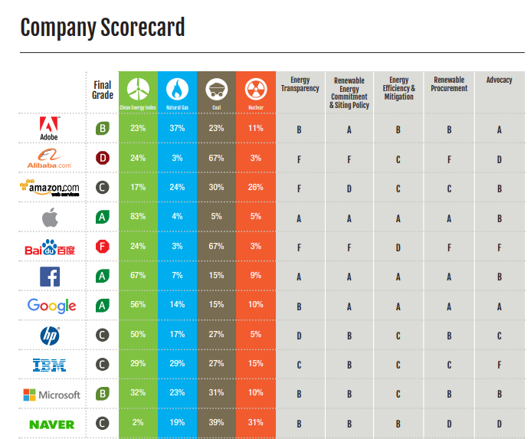
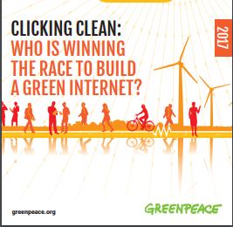
Tools and Resources

Slide 24
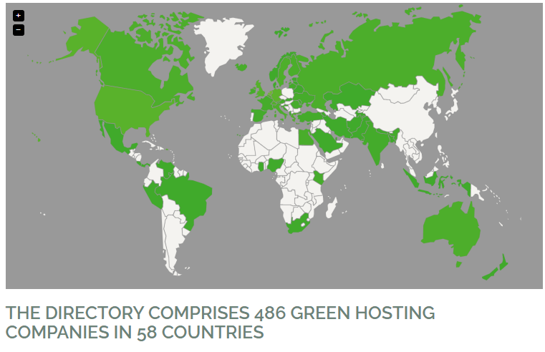
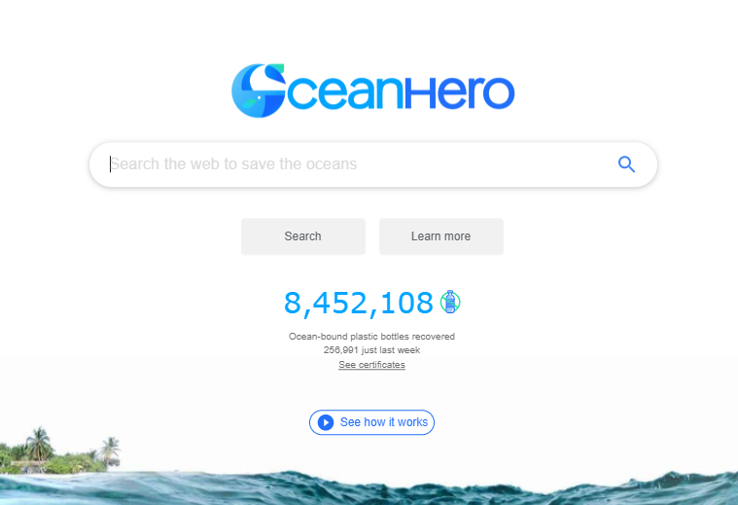
Hosting and Surfing Green
Notes:
recover one ocean-bound plastic bottle for every 5 searches.
Use a green host: The Green Web Foundation app allows you to see whether a website is hosted ‘green or grey’ as you visit it or find a green host for your webpage through their Green Hosting Directory. This calculator allows you to measure the carbon footprint of your website, Ecometer allows you to design and build more sustainable web services with tailored recommendations and Erjjio provide free website health checks.

Slide 25
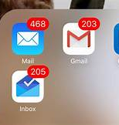
Tackle your digital waste!
Unsubscribe
Delete
Move data to the cloud where possible

Slide 26
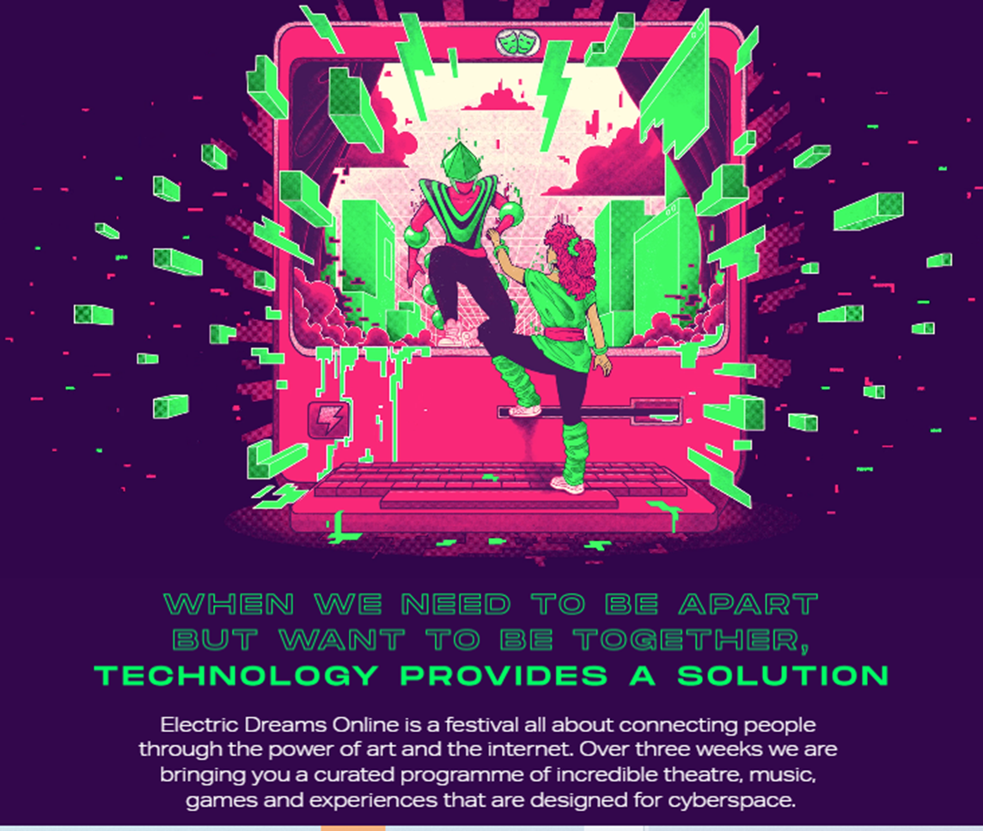
Use your voice, engage your audiences
Exit Productions: Eco Chambers
Electric Dreams Festival
Apocalypse Reading Room: Ama Josephine Budge
Notes:
• Ask your technical and digital providers for their environmental and energy reports and what they are doing to address their impacts. You can also add your voice to existing campaigns -see Greenpeace’s Tell Netflix to Go Green campaign as a starter.
• Use your digital art to engage audiences in sustainability, and share with other organisations what you are doing to reduce your digital impacts. Exit Productions ‘Eco-Chambers’ used online theatre to engage their audiences in debating what a sustainable, just society future should look like. Apocalypse Reading Rooms is an online world of ‘talking stories in the face of environmental and social collapse, a gathering of all the books we might need to change the end of the world.’
• Encourage and support your staff to switch energy provider when working from home to a renewable provider such as Good Energy.
he Apocalypse Reading Room is an on-site library curated by Ama Josephine Budge: a world of talking stories in the face of environmental and social collapse, a gathering of all the books we might need to change the end of the world…

Slide 27
Guest Speaker: Dan Barnard, Fast Familiar

Slide 28
Summary
Choose your devices carefully
Digital has a footprint! Understand what can be measured
Think Circular! – design, longevity, repair, pass on, recycle
Switch Provider- Accountability and Transparency
Efficiency: Focus on Design
Tackle your E-waste and hoarding habits
Use your voice

Slide 29
Q&A
Please write questions in Q&A

